Slide 1
CSE 205 Final Exam Review
Tuesday April 28th

Slide 2
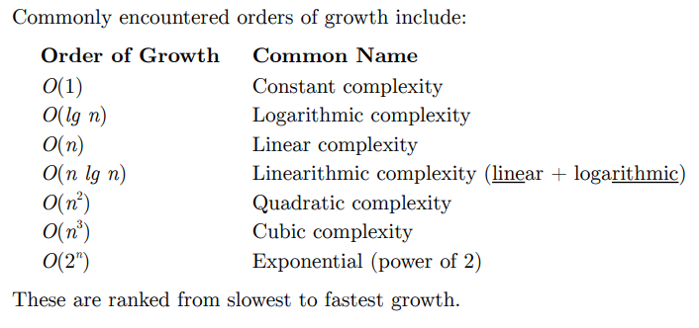
Big O Notation – Time Complexity
Measure of the “efficiency” of sorting algorithms under the worst conditions.
We use the key operation of an algorithm to determine its time complexity.
Why can we not use a stopwatch?

Slide 3
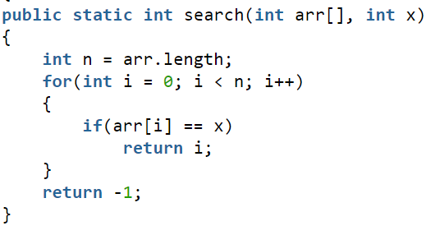
Determine the Time Complexity
Operation
# Of Executions
Time Complexity
Key Operation
Answer

Slide 4
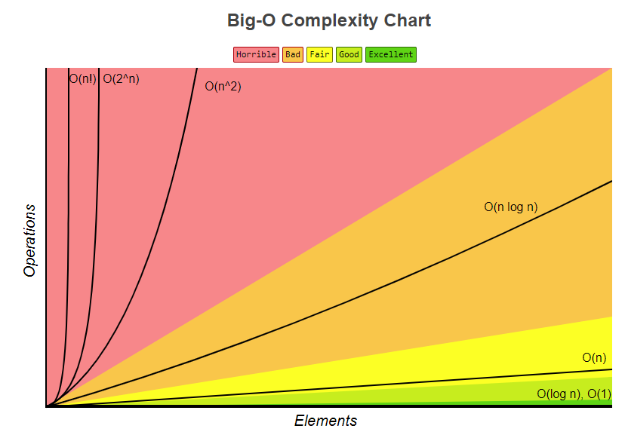
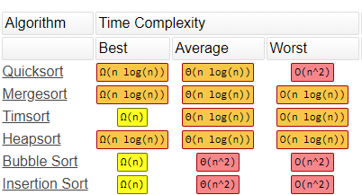
Big O
https://www.bigocheatsheet.com/

Slide 5
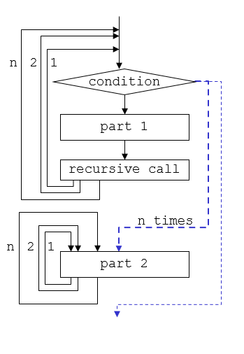
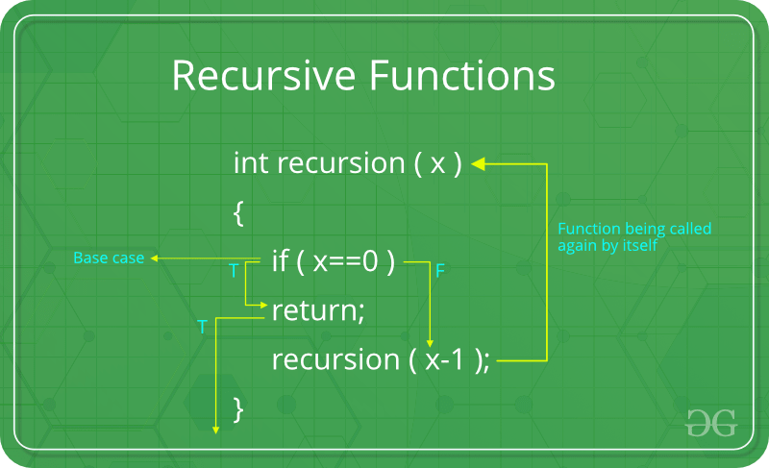
Recursion
A method that calls itself.
A problem broken down into smaller sub-problems.
Has a base-case where the problem cannot become any smaller and the method returns.

Slide 6
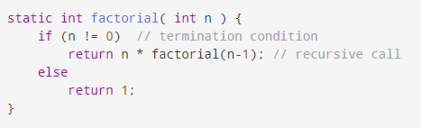
Trace the Recursive Method
We want to trace factorial(4):

Slide 7
Searching Algorithms

Slide 8
Good News!
From the Final Exam Information & Start Page:

Slide 9
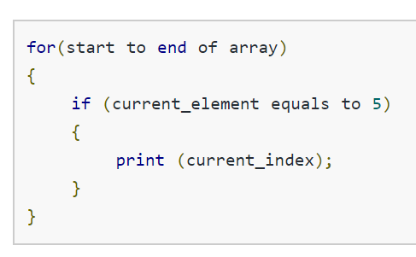
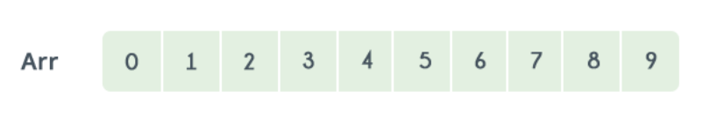
Linear Search
Pseudocode:

Slide 10
Linear Search – Time Complexity
Best Case: Array or Array List with 1 element
Best case: O(1)
Why?
Worst case: O(n)
Why?
N(1)
This is either the element we are looking for or the element is not in the list.
The key operation is only performed once.
Worst Case: Array or Array List with n elements
N(1) | N(2) | N(3) | N(4) | N(5) | … | N(n-1) | N(n)
This is either the element we are looking for or the element is not in the list.
The key operation is performed n times.

Slide 11
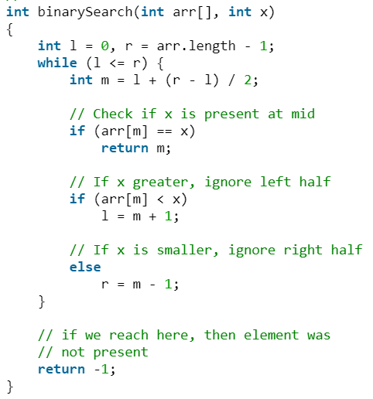
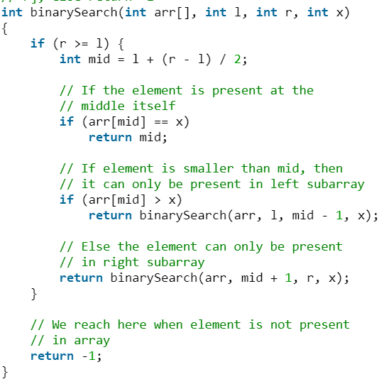
Binary Search
Iterative:
Recursive:

Slide 12
Binary Search Visualization
https://www.cs.usfca.edu/~galles/visualization/Search.html

Slide 13
Binary Search – Reminders
We can only perform binary search on a sorted list
The midpoint comparison does not work on unsorted lists.
Best Case: O(1)
The array has only 1 element.
Worst Case: O(lg(n))
The element requested is not in the list.

Slide 14
Sorting Algorithms

Slide 15
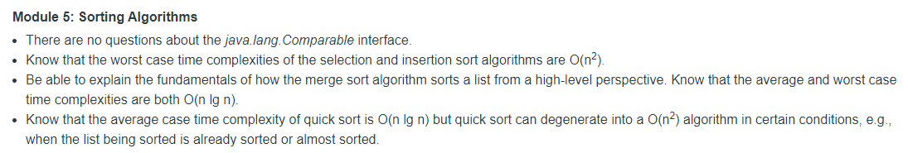
More good news!
From the Final Exam Information & Start Page:

Slide 16
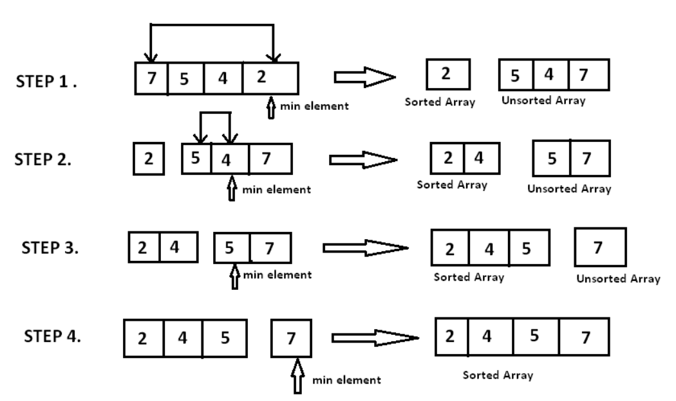
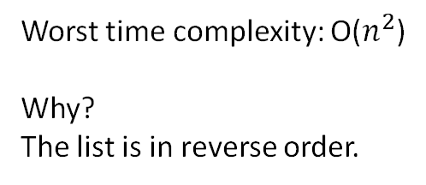
Selection Sort
Worst time complexity: O($n^{2}$)
Why?
The list is in reverse order.

Slide 17
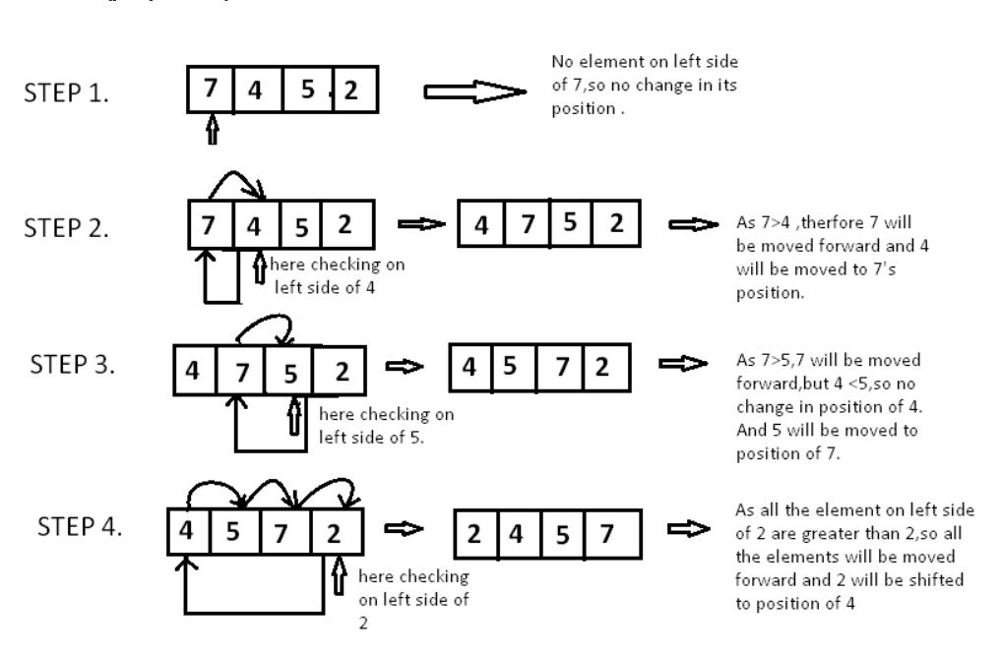
Insertion Sort:
Worst time complexity: O($n^{2}$)
Why?
The list is in reverse order.

Slide 18
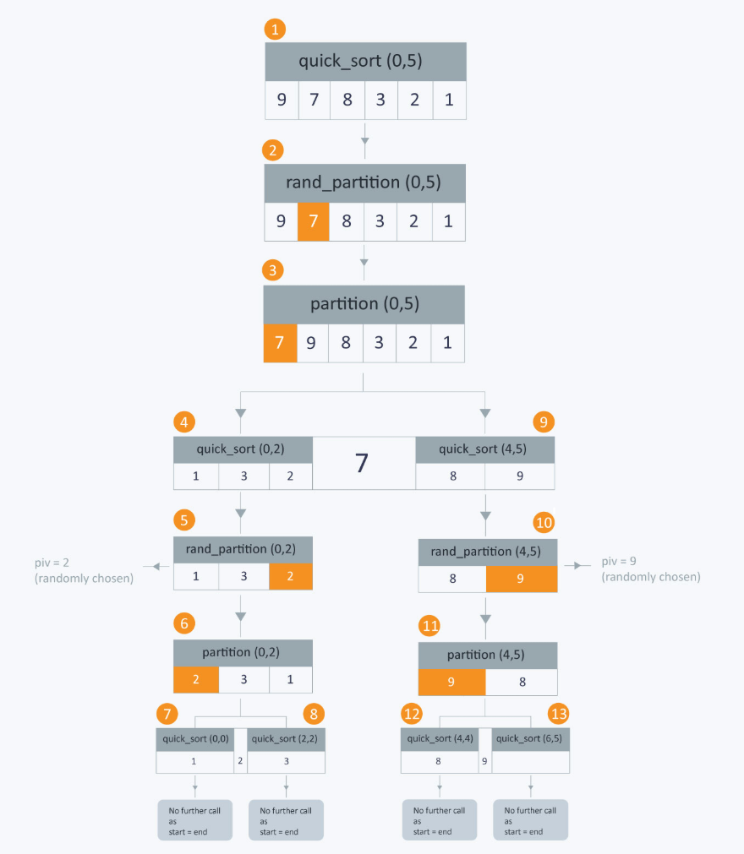
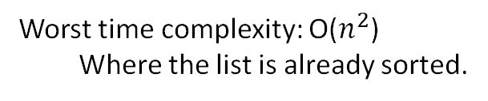
Quick Sort:
Average time complexity: O(n lg(n))
Worst time complexity: O($n^{2}$)
Where the list is already sorted.

Slide 19
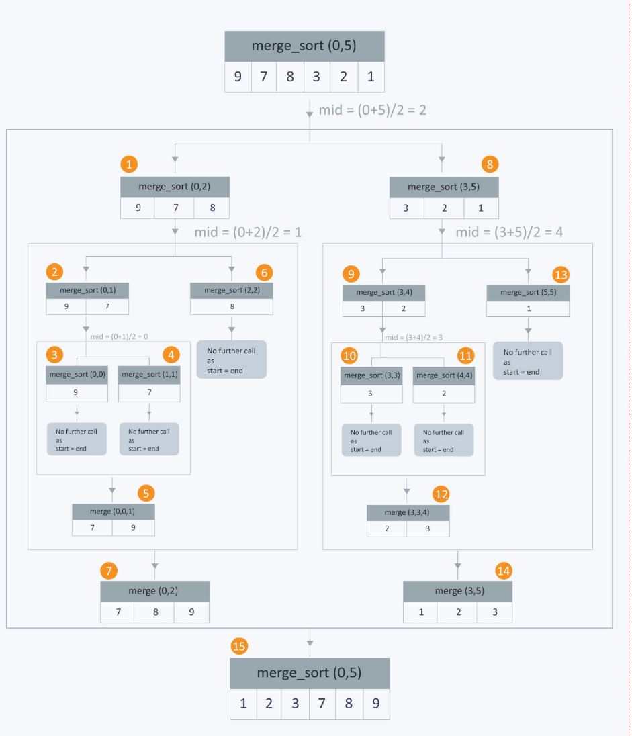
Merge Sort:
Average time complexity: O(n lg(n))

Slide 20
Data Structures

Slide 21
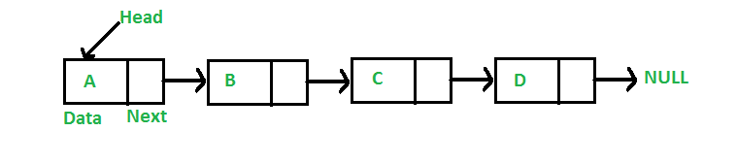
Linked Lists – Singly Linked List

Slide 22
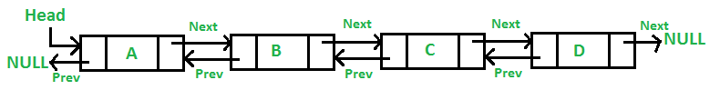
Linked Lists – Doubly-Linked Lists

Slide 23
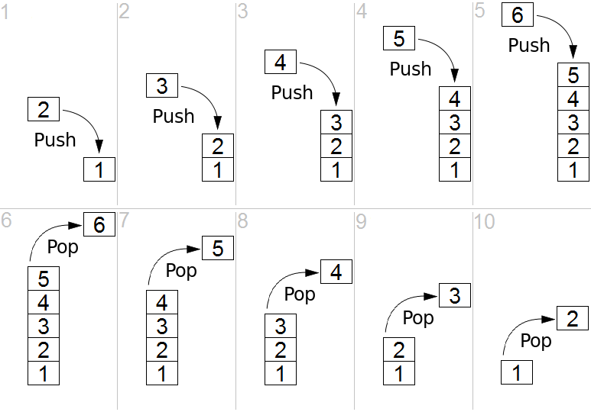
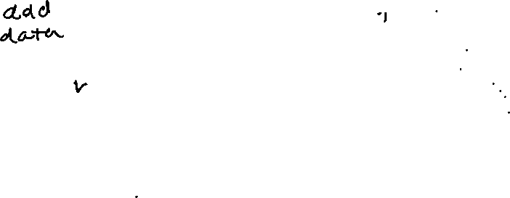
Stacks
LIFO - Last in First Out
What does peek() do?

Slide 24
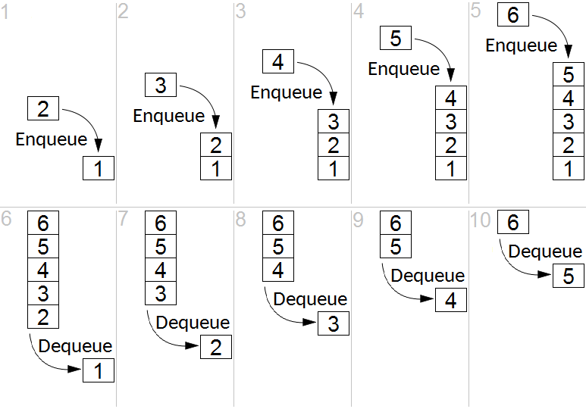
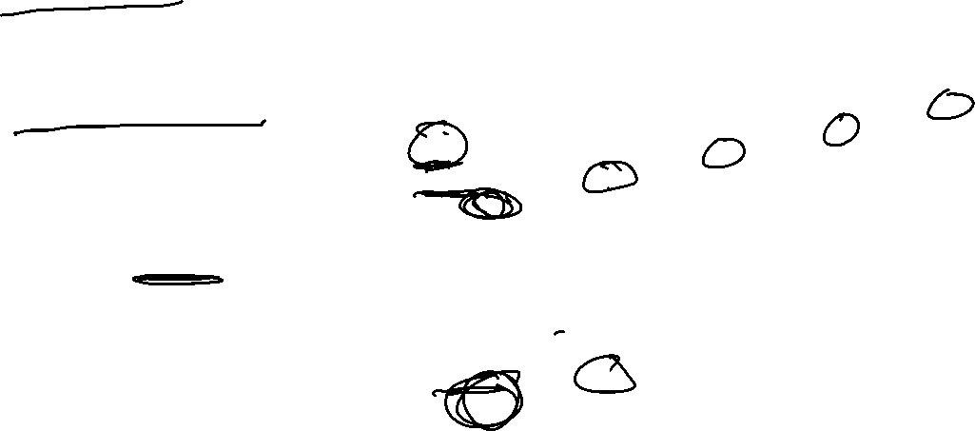
Queues
FIFO – first in first out
What does peek() do?

Slide 25
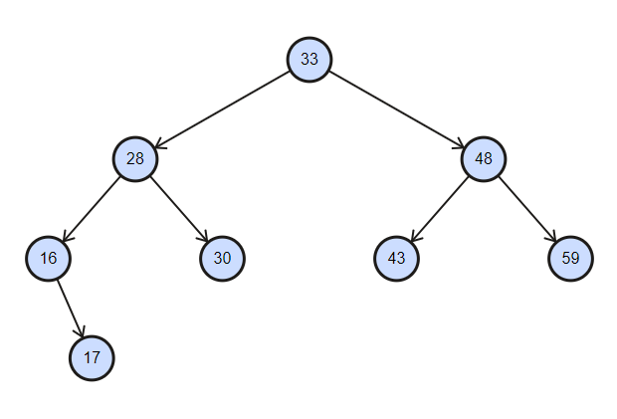
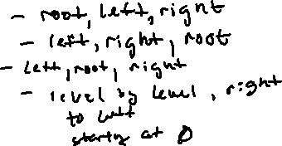
Trees & Binary Trees
Traversals:
PreOrder
PostOrder
InOrder
Breath-first
Root
A Parent Node
Binary Trees:
Sorted
A Child Node
Leaf Nodes

Slide 26
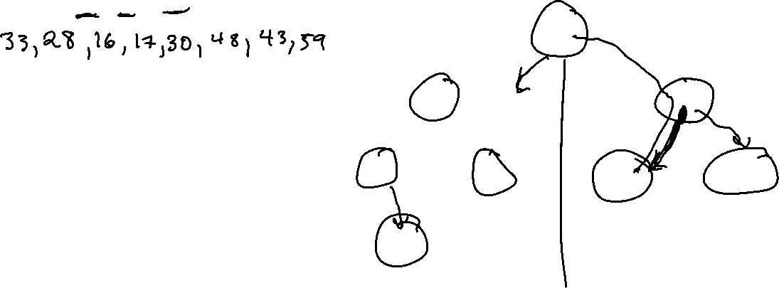
Binary Trees - Preorder
Preorder – root, left, right
Notes:
Answer: 33 28 16 17 30 48 43 59

Slide 27
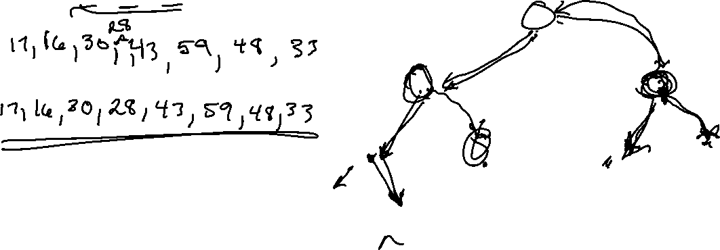
Binary Trees - Postorder
Postorder – left, right, root
Notes:
Answer: 17 16 30 28 43 59 48 33

Slide 28
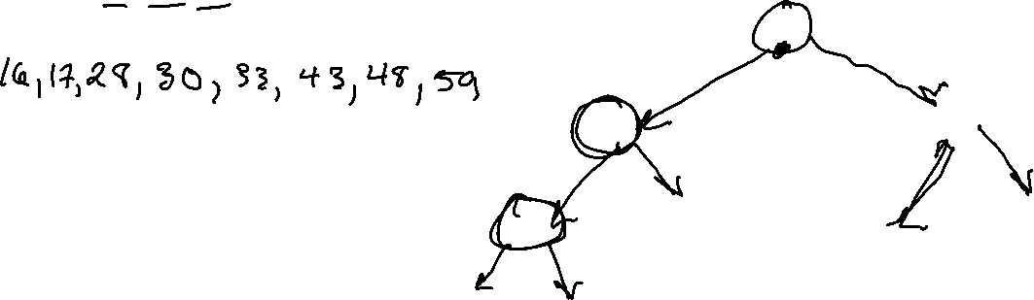
Binary Trees - Inorder
Inorder – left root right
Notes:
Answer: 16 17 28 30 33 43 48 59

Slide 29
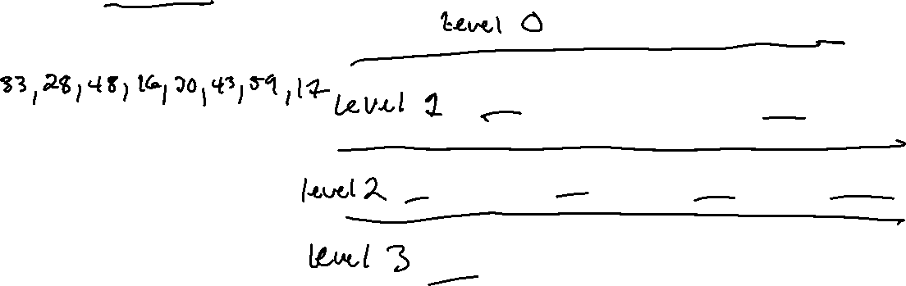
Binary Trees – Breath-First
Breath- First: level by level, left, to right, starting at level 0
Notes:
Answer: 33 28 48 16 30 43 59 17

Slide 30
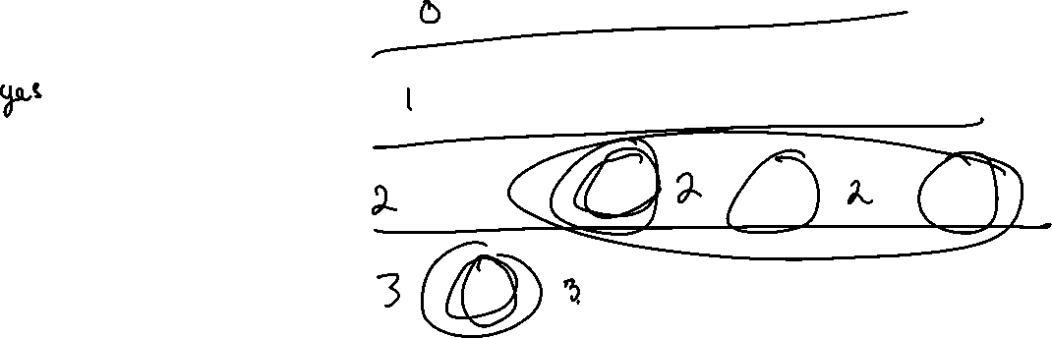
Binary Trees - Balancing
A binary tree is balanced when the levels of the leaf nodes do not differ by more than one
Is this tree balanced?

Slide 31
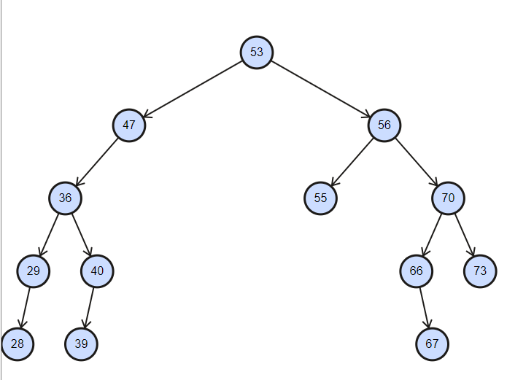
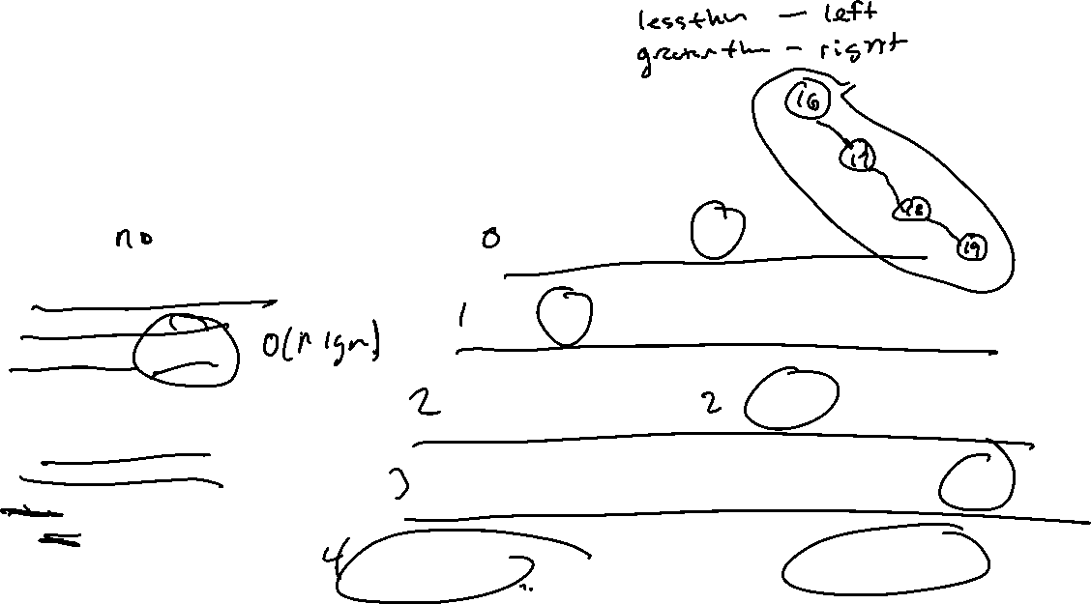
Binary Trees - Balancing
Is this tree balanced?
Time complexity of well- balanced binary tree operations – O(lg n)
Worse case for an unbalanced binary tree – O(n)
Why?

Slide 32
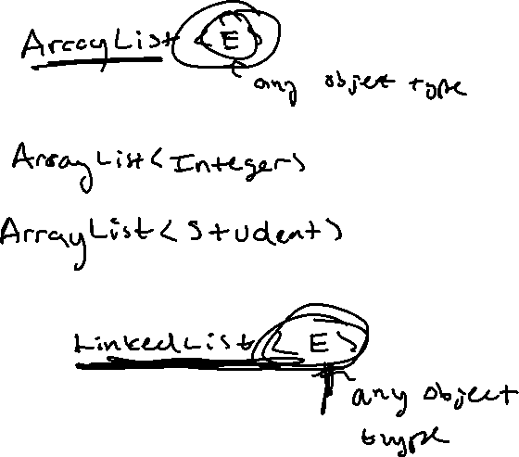
Questions?
Alex Amaya
amamaya2@asu.edu

